Slide 1
Tokenization of Real Estate
Pie and Thai

Slide 2

Camber Sand and The Restaurant

Slide 3
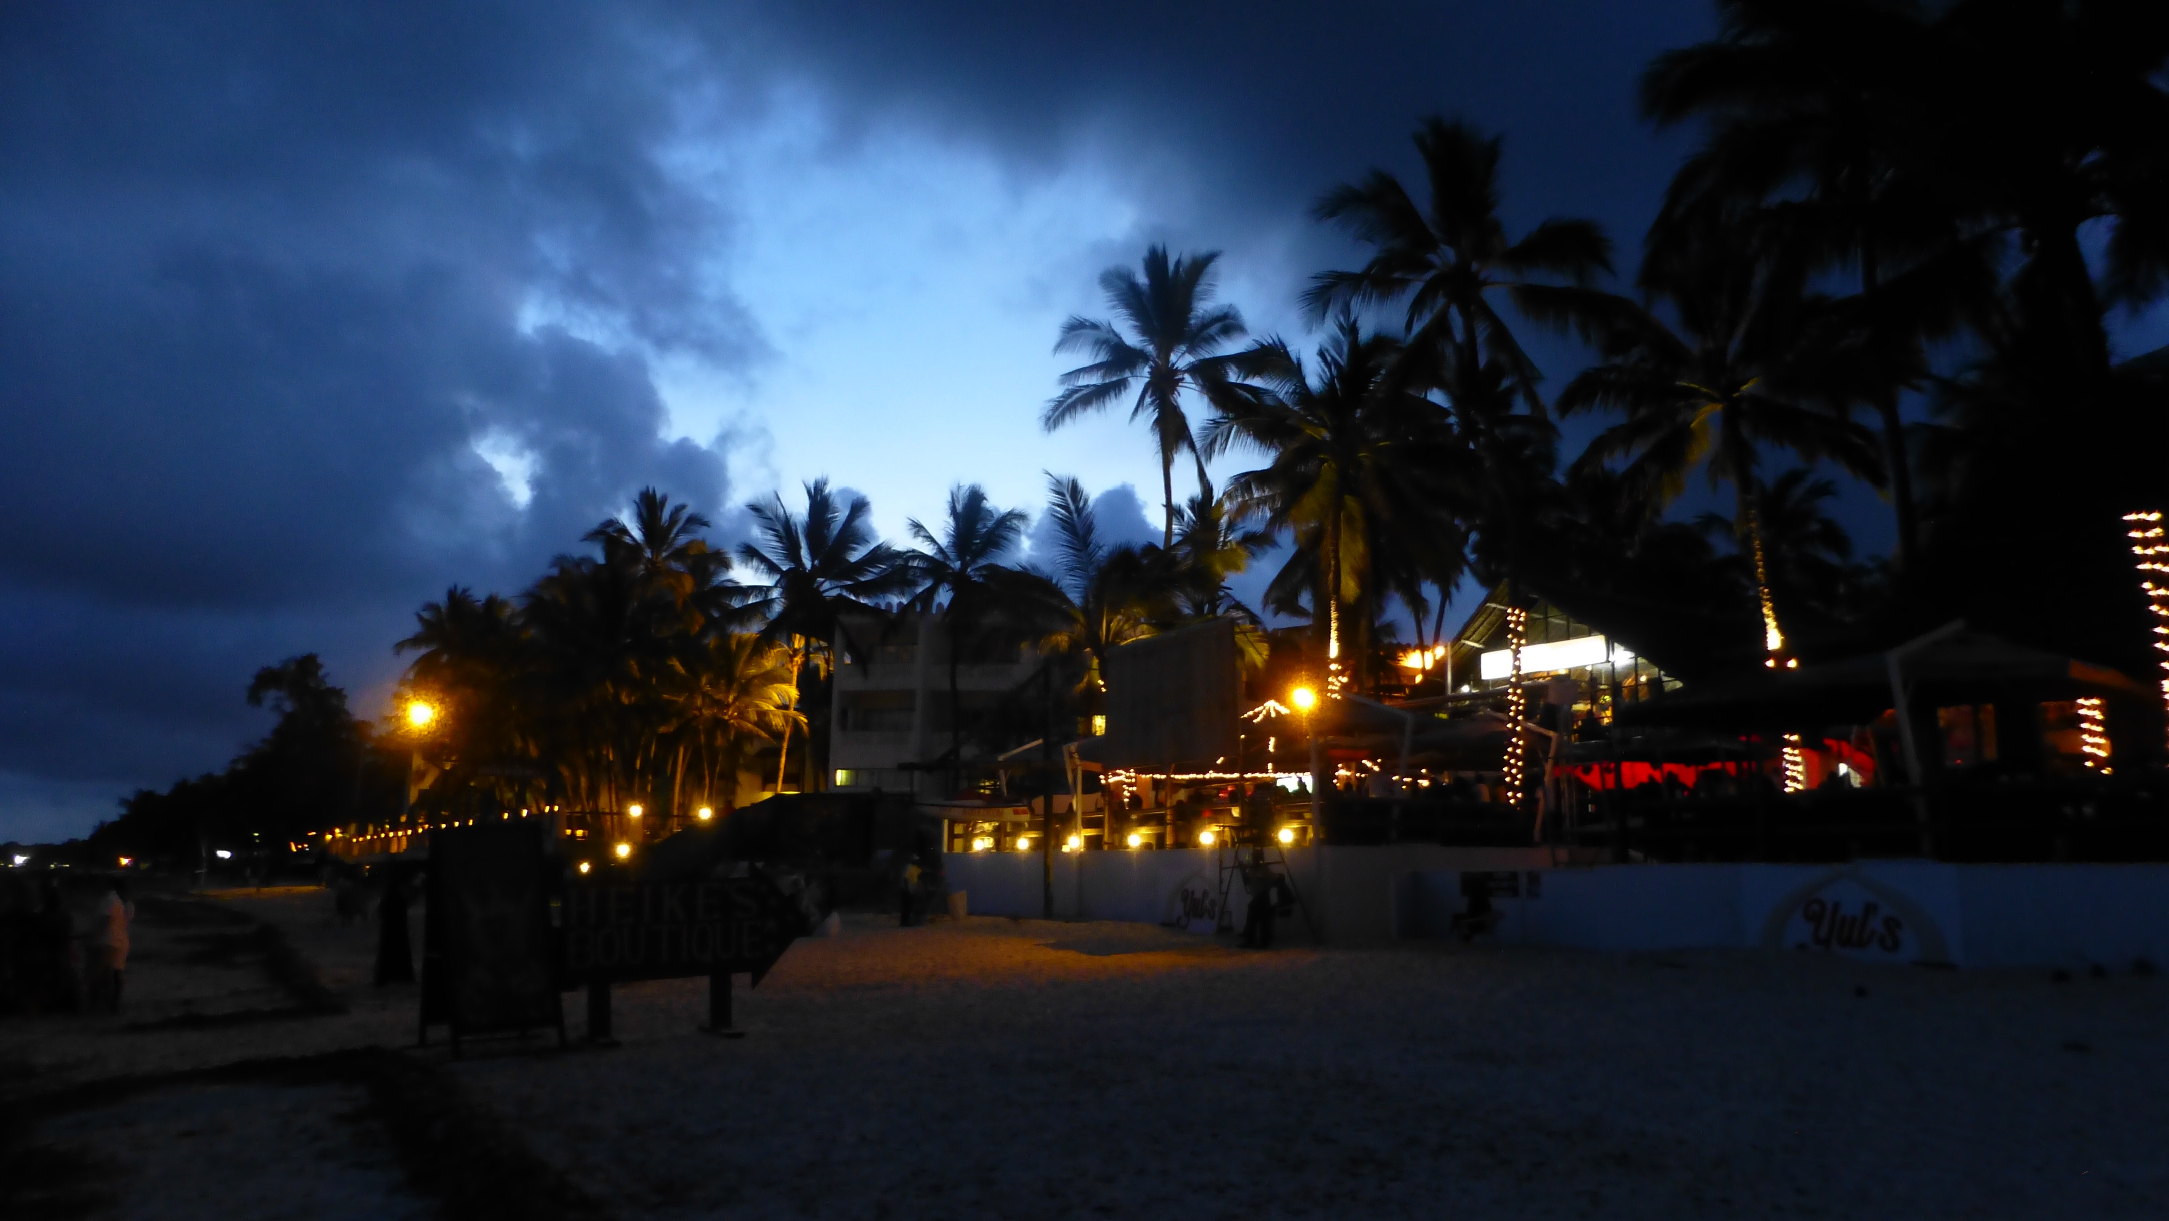
Deal Structure
Company Name
“Pie and Thai”
1
Location –
East Sussex, in the camber village
2
Property –
The restaurant is adjacent to the beach.
3

Slide 4
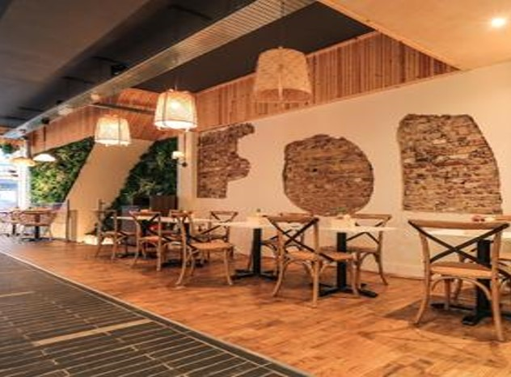
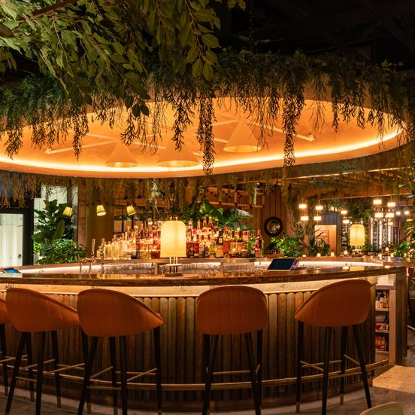
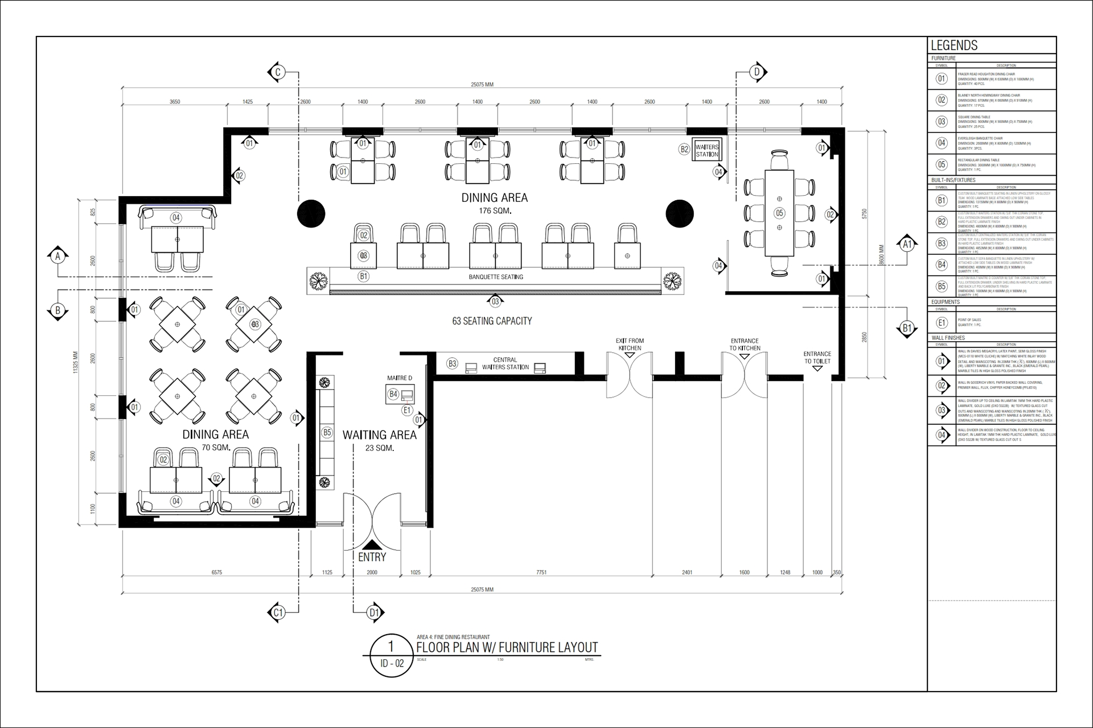
Add a Slide Title - 3
Description of the Property –
Its 2000 square feet of kitchen and sitting area with an attractive bar section.
The architectural beauty of the vast lobby, the bar section and the reception attracts the tourists
Only Restaurants near the beach; people enjoy the fresh seafood for lunch.

Slide 5
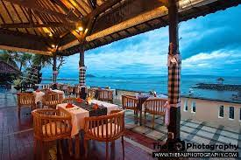
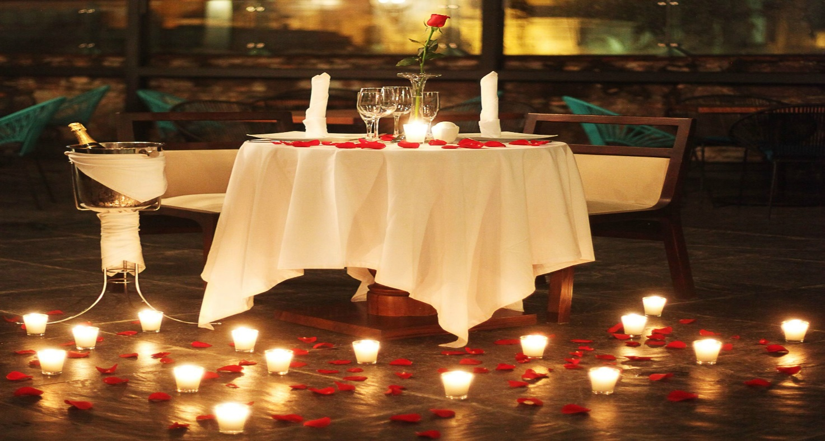

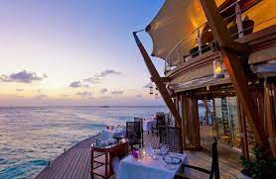
hhhh
Famous for :
Seafood
Candle light dinners
Drinks in Summer
Architectural beauty along with natural Beauty
Our Customer Service

Slide 6
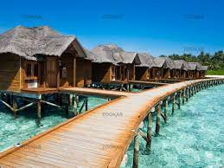
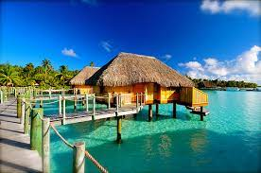

Upcoming Facilities –
Book a cottage and spend a night on the sea
Reason for Tokenizing the Property.

Slide 7
Digitization
Tokenization
Financial Model
Company Name | Pie and Thai
Tracker | P&T TOKEN (PTK)
Ticker | PTK
Decimal | 4
Blockchain | Ethereum
Property Value | 800,000 USD
Total Offering | 800,000
Price per Token | 1 USDT
Minimum Investment | 100 USDT
Private Sell (Pre- ICO) | 40%
ICO | 60%
Expected Return | 5%

Slide 8
Allocation of Token
Owners | 20%
Development Team | 10%
Staffs & Customers | 10%
Public | 60%

Slide 9
Primary Distribution of Token
Private and Public Selling –
20% is allocated to the owners
10% will be offered to the Development team & the planners of our Future project.
The next 10% will be offered to the employees and to some Loyal Customers.
Rest of the 60% will be offered to the public.
1 PTK | 6 USD | Private Sell
1 PTK | 8 USD | Private Sell
1 PTK | 10 USDT | ICO

Slide 10
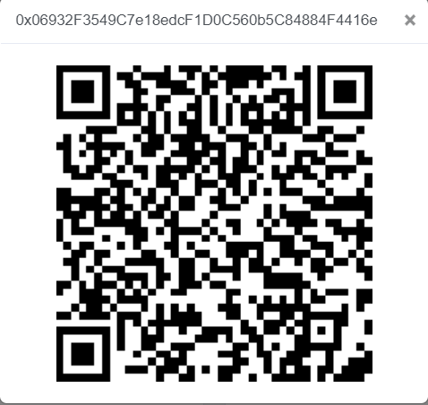
Buying Process of the Token
Create a Wallet
Deposit Money
Get USDT from an Exchange
Look for the Wallet Address or QR code
Get the Tokens
Transfer USDT - 0x89841074a638E8aff0c34ec41553B0Fc56757205

Slide 11

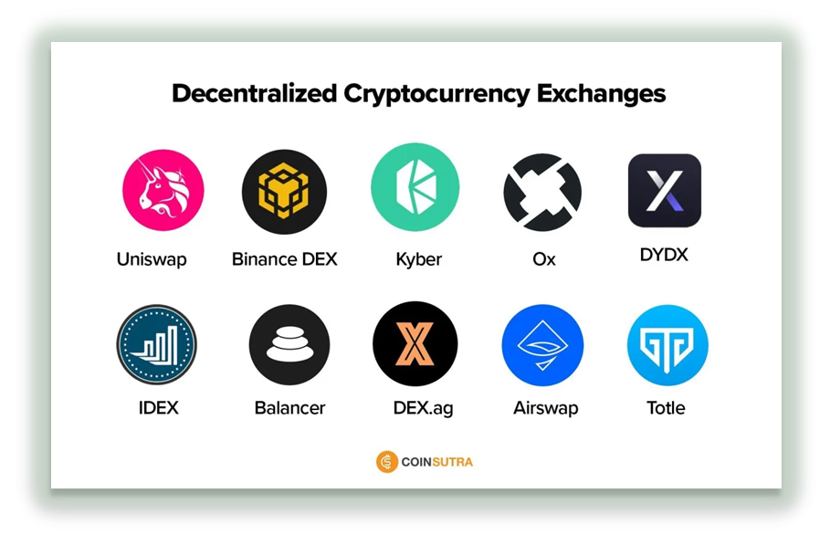
Decentralized Exchange
After Selling all the Tokens in ICO ( Initial Coin Offering) the Business will Enlist the Tokens in a Decentralized Platform, which is UNISWAP.

Slide 12


Benefits of Holding the TOKEN
The Tokens will be connected to the Restaurant’s Revenues.
The Primary Investors can sell them in the Decentralized market at higher prices.
The Tokens will be enlisted in the UNISWAP within 6 months.
Investors who own at least 30% of the Token and will hold them for at least one year, will get an NFT.
Investors can expect a 5% return in the following year.

Slide 13
